Slide 1
Lecture # 01 Introduction to Parallel and Distributed Computing
Parallel and Distributed Computing
CS-482

Slide 2
Computing History
Introduction to Early Computers:
ENIAC and UNIVAC in the 1940s and 1950s.
Massive room sized structures with vacuum tubes.
Limited processing capabilities compared to contemporary technology.
Evolution to Mainframes:
Transition in the mid20th century.
IBM System/360 as a milestone in the 1960s.
Room sized mainframe computers with enhanced processing power.
Personal Computers Era:
Late 20thcentury rise of personal computers.
Apple and Microsoft pivotal in popularizing personal computing.
Introduction of user-friendly interfaces and affordable hardware.
Apple II (1977) and IBM PC (1981) marked the beginning
Notes:
Introduction to Early Computers:
Early computing devices, such as the ENIAC (Electronic Numerical Integrator and Computer) and UNIVAC (Universal Automatic Computer), marked the dawn of the digital age. These machines, developed in the 1940s and 1950s, were behemoths, filling entire rooms with their intricate wiring and vacuum tubes. Despite their massive size, they possessed limited processing capabilities compared to today's standards. The ENIAC, for instance, weighed 30 tons and could perform basic arithmetic calculations at speeds unimaginable at the time, yet still significantly slower than modern pocket calculators.
Evolution to Mainframes:
In the mid-20th century, computing technology underwent a significant transformation with the advent of mainframe computers. These room-sized machines, exemplified by the IBM System/360, represented a leap forward in computing power and versatility. Introduced in 1964, the IBM System/360 series standardized computing architecture, offering compatibility across various models and providing unprecedented processing capabilities for businesses, governments, and academic institutions.
Personal Computers Era:
The late 20th century witnessed the democratization of computing with the rise of personal computers (PCs). Companies like Apple and Microsoft played pivotal roles in popularizing personal computing by introducing user-friendly interfaces and affordable hardware. The Apple II, launched in 1977, and the IBM PC, introduced in 1981, marked the beginning of a new era, empowering individuals to have computing power at their fingertips.
Moore's Law:
Moore's Law, formulated by Intel co-founder Gordon Moore in 1965, predicts that the number of transistors on a microchip doubles approximately every two years. This exponential growth has fueled the rapid advancement of processing power, leading to smaller, faster, and more efficient computers. Moore's Law has been a driving force behind technological innovation, enabling the development of increasingly powerful and compact devices, from smartphones to supercomputers, and revolutionizing nearly every aspect of modern life.

Slide 3
Computing History
Moore's Law:
Formulated by Gordon Moore in 1965.
Predicts doubling of transistors on a microchip every two years.
Drives exponential growth in processing power.
Facilitates development of smaller, faster, and more efficient computers.
Influences technological innovation across various devices.
Revolutionizes modern life, impacting smartphones to supercomputers..
Notes:
Introduction to Early Computers:
Early computing devices, such as the ENIAC (Electronic Numerical Integrator and Computer) and UNIVAC (Universal Automatic Computer), marked the dawn of the digital age. These machines, developed in the 1940s and 1950s, were behemoths, filling entire rooms with their intricate wiring and vacuum tubes. Despite their massive size, they possessed limited processing capabilities compared to today's standards. The ENIAC, for instance, weighed 30 tons and could perform basic arithmetic calculations at speeds unimaginable at the time, yet still significantly slower than modern pocket calculators.
Evolution to Mainframes:
In the mid-20th century, computing technology underwent a significant transformation with the advent of mainframe computers. These room-sized machines, exemplified by the IBM System/360, represented a leap forward in computing power and versatility. Introduced in 1964, the IBM System/360 series standardized computing architecture, offering compatibility across various models and providing unprecedented processing capabilities for businesses, governments, and academic institutions.
Personal Computers Era:
The late 20th century witnessed the democratization of computing with the rise of personal computers (PCs). Companies like Apple and Microsoft played pivotal roles in popularizing personal computing by introducing user-friendly interfaces and affordable hardware. The Apple II, launched in 1977, and the IBM PC, introduced in 1981, marked the beginning of a new era, empowering individuals to have computing power at their fingertips.
Moore's Law:
Moore's Law, formulated by Intel co-founder Gordon Moore in 1965, predicts that the number of transistors on a microchip doubles approximately every two years. This exponential growth has fueled the rapid advancement of processing power, leading to smaller, faster, and more efficient computers. Moore's Law has been a driving force behind technological innovation, enabling the development of increasingly powerful and compact devices, from smartphones to supercomputers, and revolutionizing nearly every aspect of modern life.

Slide 4
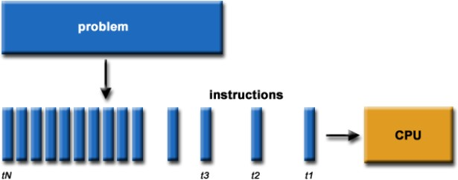
Serial Computation:
Traditionally software has been written for serial computations:
To be run on a single computer having a single Central Processing Unit (CPU)
A problem is broken into a discrete set of instructions
Instructions are executed one after another
Only one instruction can be executed at any moment in time

Slide 5
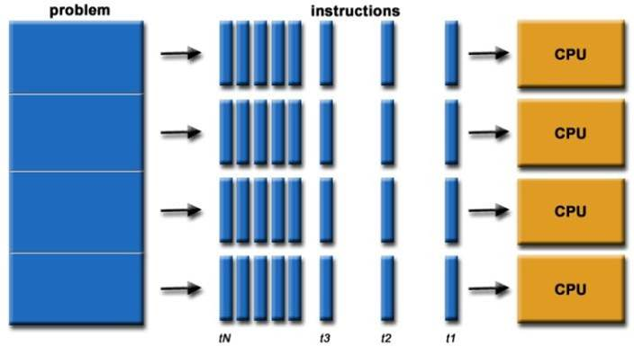
Introduction to Parallel Computing
In the simplest sense, parallel computing is the simultaneous use of multiple compute resources to solve a computational problem:
To be run using multiple CPUs
A problem is broken into discrete parts that can be solved concurrently
Each part is further broken down to a series of instructions
Instructions from each part execute simultaneously on different CPUs

Slide 6
What is Parallel Computing?
In parallel computing multiple processors performs multiple tasks assigned to them simultaneously. Memory in parallel systems can either be shared or distributed. Parallel computing provides concurrency and saves time and money.
Examples
Blockchains, Smartphones, Laptop computers, Internet of Things, Artificial intelligence and machine learning, Space shuttle, Supercomputers are the technologies that uses Parallel computing technology.

Slide 7
Advantages of Parallel Computing
Increased Speed: In this technique, several calculations are executed concurrently hence reducing the time of computation required to complete large scale problems.
Efficient Use of Resources: Takes full advantage of all the processing units it is equipped with hence making the best use of the machine’s computational power.
Scalability: Also, the more processors built into the system, the more complex problems can be solved within a short time.
Improved Performance for Complex Tasks: Best suited for activities which involve a large numerical calculation like, number simulation, scientific analysis and modeling and data processing.

Slide 8
Disadvantages of Parallel Computing
Complexity in Programming: Parallel writing programming that is used in organizing tasks in a parallel manner is even more difficult than that of serial programming.
Synchronization Issues: Interaction of various processors when operating concurrently can become synchronized and result in problem areas on the overall communication.
Hardware Costs: The implementation of parallel computing does probably involve the use of certain components such as multi-core processors which could possibly be costly than the normal systems.

Slide 9
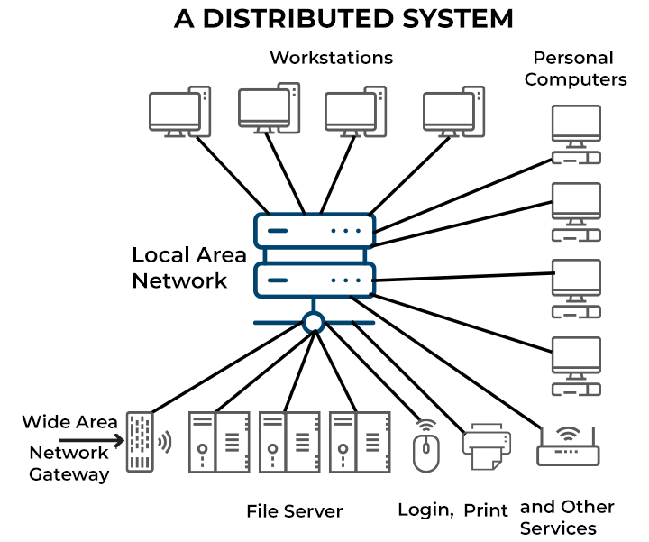
Introduction to Distributed Computing

Slide 10
What is Distributed Computing?
In distributed computing we have multiple autonomous computers which seems to the user as single system. In distributed systems there is no shared memory and computers communicate with each other through message passing. In distributed computing a single task is divided among different computers.
Examples
Artificial Intelligence and Machine Learning, Scientific Research and High-Performance Computing, Financial Sectors, Energy and Environment sectors, Internet of Things, Blockchain and Cryptocurrencies are the areas where distributed computing is used.

Slide 11
Advantages of Distributed Computing
Fault Tolerance: The failure of one node means that this node is no longer part of the computations, but that is not fatal for the entire computation since there are other computers participating in the process thereby making the system more reliable.
Cost-Effective: Builds upon existing hardware and has flexibility in utilizing commodity machines instead of the need to have expensive and specific processors for its use.
Scalability: The distributed systems have the ability to scale and expand horizontally through the addition of more machines in the networks and therefore they can take on greater workloads and processes.
Geographic Distribution: Distributed computing makes it possible to execute tasks at different points thereby eliminating latencies.

Slide 12
Disadvantages of Distributed Computing
Complexity in Management: The task of managing a distributed system itself can be made more difficult since it may require dealing with the latency and/or failure of a network as well as issues related to synchronizing the information to be distributed.
Communication Overhead: Inter node communication requirements can actually hinder the package transfer between nodes that are geographically distant and hence the overall performance is greatly compromised.
Security Concerns: In general, distributed systems are less secure as compared to centralized system because distributed systems heavily depend on a network.

Slide 13
Flynn’s Taxonomy
Flynn’s Taxonomy uses two basic concepts: Parallelism in instruction stream, and parallelism in data stream.
A n CPU system has n program counter, so there are n “instruction stream” that can execute in parallel.
A data stream can be used as a sequence of data, and there exist 4 possible combinations.

Slide 14
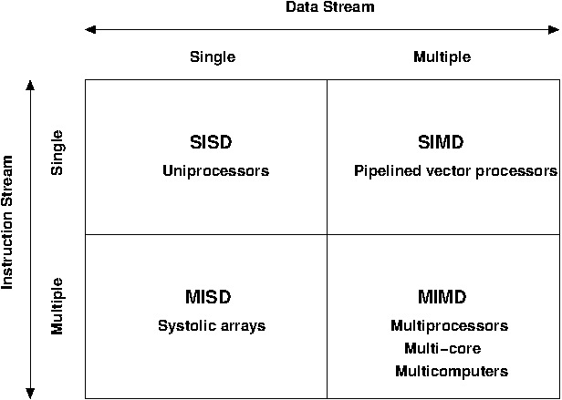
Flynn’s Classification

Slide 15
Flynn’s Classification
Insrtuction Set | Data Streams | Name | Examples
1 | 1 | SISD | Von Neumann Machine
1 | Multiple | SIMD | Vector Super Computer
Multiple | 1 | MISD | Arguably None
Multiple | Multiple | MIMD | Multiprocessor, Multicomputer

Slide 16
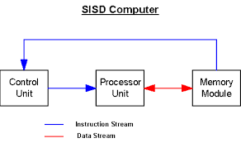
SISD(Single Instruction Single Data)
A processor that can only do one job at a time from start to finish.

Slide 17
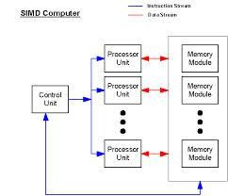
SIMD(Single Instruction Multiple Data)
Single CU and multiple PEs
CU fetches an instruction from memory and after decoding, broadcasts control signals to all PEs.
That is, at any given time, all PEs are Synchronously executing the same.
Instruction but on different sets of data; hence the name SIMD

Slide 18
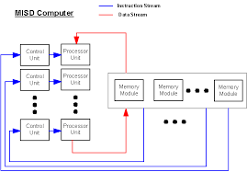
MISD(Multiple instructions single data)
A rare type, since data throughput is limited.

Slide 19
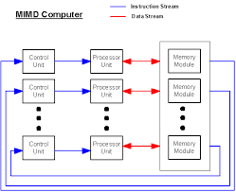
MIMD(Multiple instruction Multiple Data)
A MIMD is a true multiprocessor
In contrast to SIMD, a MIMD is a general-purpose machine.
When all the processor in MIMD are running the same program, we call it Single Program Multiple Data(SPMD) computation.
The SPMD model is widely used by many parallel platforms.

Slide 20
Concepts of parallel programs communication:
Most parallel applications require tasks to share data with each other.
Cost of communication: Computational resources are used to package and transmit data. Requires frequently synchronization – some tasks will wait instead of doing work. Could saturate network bandwidth.
Latency vs. Bandwidth: Latency is the time it takes to send a minimal message between two tasks. Bandwidth is the amount of data that can be communicated per unit of time. Sending many small messages can cause latency to dominate communication overhead.
Synchronous vs. Asynchronous communication: Synchronous communication is referred to as blocking communication – other work stops until the communication is completed.
Asynchronous communication is referred to as nonblocking since other work can be done while communication is taking place.
Scope of communication: Point to point communication – data transmission between tasks.
Collective communication – involves all tasks (in a communication group)
This is only partial list of things to consider!

Slide 21
Comparison
 | Parallel Computing | Distributed Computing
Memory Architecture | Shared memory architecture | Each node has its own memory
Communication | High bandwidth, low latency within processors | Relies on message passing over a network
Task Focus | Solves a single complex problem by dividing it into smaller tasks | Handles multiple tasks simultaneously, often involving large datasets
Scalability | Limited by the number of processors and shared memory capacity | Scales horizontally by adding more machines to the network
Coordination | Requires synchronization for coordination | Each node operates independently, coordination is through message passing

Slide 22
Difference between Parallel Computing and Distributed Computing:
Parallel Computing | Distributed Computing
Many operations are performed simultaneously | System components are located at different locations
Single computer is required | Uses multiple computers
Multiple processors perform multiple operations | Multiple computers perform multiple operations
It may have shared or distributed memory | It have only distributed memory
Processors communicate with each other through bus | Computer communicate with each other through message passing.
Improves the system performance | Improves system scalability, fault tolerance and resource sharing capabilities

Slide 23
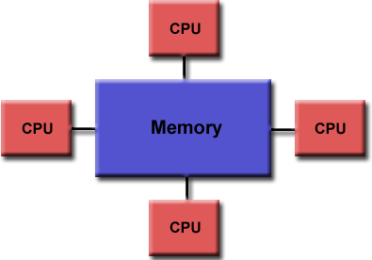
Parallel Computer Memory Architectures:
Shared Memory:
Multiple processors can operate independently, but share the same memory resources
Changes in a memory location caused by one
CPU are visible to all processors
Advantages:
Global address space provides a user-friendly programming perspective to memory
Fast and uniform data sharing due to proximity of memory to CPUs
Disadvantages:
Lack of scalability between memory and CPUs. Adding more CPUs increases traffic on the shared memoryCPU path
Programmer responsibility for “correct” access to global memory

Slide 24
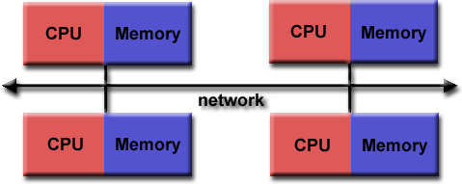
Parallel Computer Memory Architectures:
Distributed Memory:
Requires a communication network to connect interprocessor memory
Processors have their own local memory. Changes made by one CPU have no effect on others
Requires communication to exchange data among processors
Advantages:
Memory is scalable with the number of CPUs
Each CPU can rapidly access its own memory without overhead incurred with trying to maintain global cache coherency
Disadvantages:
Programmer is responsible for many of the details associated with data communication between processors
It is usually difficult to map existing data structures to this memory organization, based on global memory

Slide 25
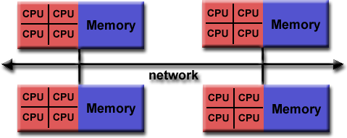

Parallel Computer Memory Architectures:
Hybrid Distributed Shared Memory:
The largest and fastest computers in the world today employ both shared and distributed memory architectures.
Shared memory component can be a shared memory machine and/or GPU
Processors on a compute node share same memory space
Requires communication to exchange data between compute nodes
Advantages and Disadvantages:
Whatever is common to both shared and distributed memory architectures
Increased scalability is an important advantage
Increased programming complexity is a major disadvantage

Slide 26
Conclusion
Parallel Computing and Distributed Computing are effective computational models developed with an aim to solve large calamities. Parallel computing is suitable for accelerating computations of a single machine or clustered machines, with emphasis on the rate of processing. On the hand, distributed on the other has many separate and independent computers that are connected over the network focusing on scalability and fault tolerance. Each of the models presented has it own strength and weakness, therefore, the choice between them depends on the conditions of the particular application or system.

